Slide 1

DISONY ENTERTAINMENT
SECURITY AUDIT REPORT
BY LUWAM, MADALINA, MATTHIAS, RYAN, AND WARREN

Slide 2
PURPOSE OF THIS REPORT
To present the need for increased funding to expand the IT and software development staff by addressing security issues within three crucial areas: Point of Sale (PoS), Local Area Network (LAN), and Web Server Application. By providing a detailed analysis of the vulnerabilities and potential risks in these domains, we aim to persuade the companies board of directors of the necessity for additional resources to bolster our digital defenses effectively.

Slide 3
ABOUT DISONY ENTERTAINMENT
Disony is a consumer-facing retailer selling a variety of entertainment products.
We have a single corporate office with over 50 employees.
$2 million in annual sales were conducted on the company website last year.
$3 million in sales were done through Amazon.
$5 million in sales were done through the 10 company stores located in 10 states.

Slide 4
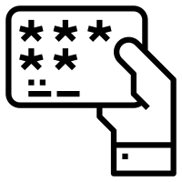
ABOUT DISONY ENTERTAINMENT
Disony has 19,549 customer names, email and mailing addresses stored from previous online transactions in the past 10 years.
8,292 of these customers purchased at least one item in the past 12 months.
2,600 customers participate in the company’s loyalty program which means they have installed the company app and stored their credit card number with us for faster checkout.
(Euatham, n.d.)

Slide 5
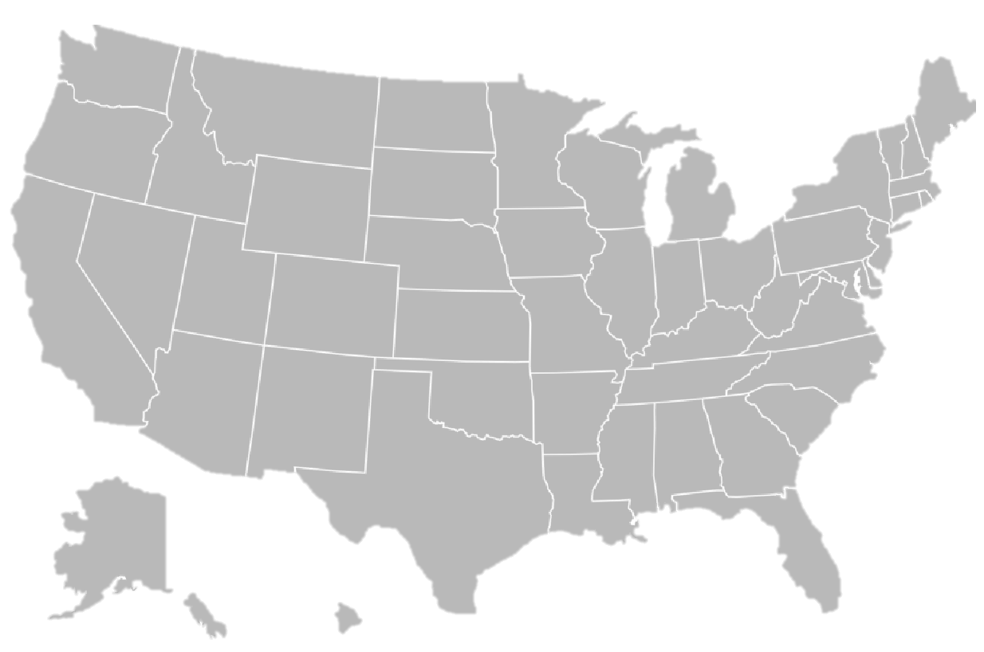
COMPANY LOCATIONS
Kirkland, WA
HQ
San Francisco
Dearborn, MI
Orem, UT
Naperville, IL
Lincoln, NE
Pasadena, CA
Tulsa, OK
Tucson, AZ
Plano, TX
Orlando, FL

Slide 6
DEFINITIONS
Vulnerability
Vulnerabilities are described as a weakness in an IT system that can be exploited by an attacker to deliver a successful attack. They can occur through flaws, features or user error.
Threat
A threat is described as a potential negative action or event facilitated by a vulnerability that can result in unwanted impact to a computer system or application.
Attack
Attacks are described as any kind of malicious activity that attempts to collect, disrupt, deny, degrade, or destroy information system resources or the information itself.

Slide 7



INTRODUCE THE EXPERTS
Hardware Systems
Integrator
Network and Server Engineer
Web Manager
Madalina & Warren
Matthias
Luwam & Ryan

Slide 8
CURRENT SITUATION
Our company uses PCs with Windows 2000 and card readers for the Point of Sales.
Most of the P.O.S. machines are at least 10 years old.
Credit card readers use magnetic strips to verify the card number.

Slide 9
CURRENT SITUATION (cont)
Our company has an internal network at the corporate office that includes file and database servers (Windows 2012 and Microsoft SQL servers) that contain very sensitive information about company business that should not be accessible to people outside of the company. While at work, employees use computers with Windows XP, 7, 8 and 10 connected through both network cables and Wi-Fi access points.
Some of our services are hosted at Amazon with AWS servers.
Customers use an iOS and Android app to make purchases.

Slide 10
CURRENT SITUATION (cont)
Our company has an active online e-commerce site. Customers login to check their investment accounts, make investment decisions and transfer funds between bank accounts. Customer passwords are encrypted using the DES (Data Encryption Standard) algorithm in order to keep them secure.
Customer account data is stored in a MySQL database.
The website was written in 2003 in the PHP language version 4.0.

Slide 11
INTRODUCE THE EXPERT
As the Hardware Systems Integrator, my role involves ensuring the security and integrity of computer accessories used by cash registers at the point of sale. This includes managing and maintaining the hardware components that facilitate transactions.
I maintain process and services like:
Security checks on transactions made at POS
POS hardware systems (including but not limited to cash registers, card terminal, etc.)
Incorporating new hardware into existing systems
Hardware Systems
Integrator
(Wikimedia Commons, 2017)

Slide 12

Recent Security Breach and It’s Cost
A recent security breach in a similar business involved hackers exploiting vulnerabilities in outdated point-of-sale (POS) systems. These attackers gained unauthorized access to POS terminals and installed malware to capture payment card data during transactions, resulting in significant financial losses due to fraud and legal penalties, as well as damage to the company's reputation.
Cost to the company:
The breach resulted in significant financial losses due to fraud.
The company faced legal penalties and damage to its reputation.
(Wikimedia Commons, 2017)
(Colin, 2013)

Slide 13
Recommendations For Updating Systems
Replace outdated point-of-sale hardware with more advanced security models
POS terminal physical security should be improved
For payment transactions, use end-to-end encryption
Effort and Cost Estimates:
Upgrading POS hardware: $20,000 for new terminals
Enhancing physical security: $5,000 for additional features
Incorporating encryption: $10,000 for software upgrades
Total estimated costs: $35,000 total
Justification:
The estimated cost of these upgrades, including hardware, software, and additional security measures, is justified by the potential losses from a data breach, making prevention through upgrades more cost-effective than dealing with the aftermath of a successful attack.
(Wikimedia Commons, 2017)
(Colin, 2013)

Slide 14
INTRODUCE THE EXPERT
Role:
Design, build, and implement new networks
Maintain existing networks
Responsibilities and Services:
Manage network including firewalls, security systems, and data backup
Installing and configuring hardware: routers, switches, load balancers, and VPN
Network and Server Engineer
(Wikimedia Commons, 2017)

Slide 15
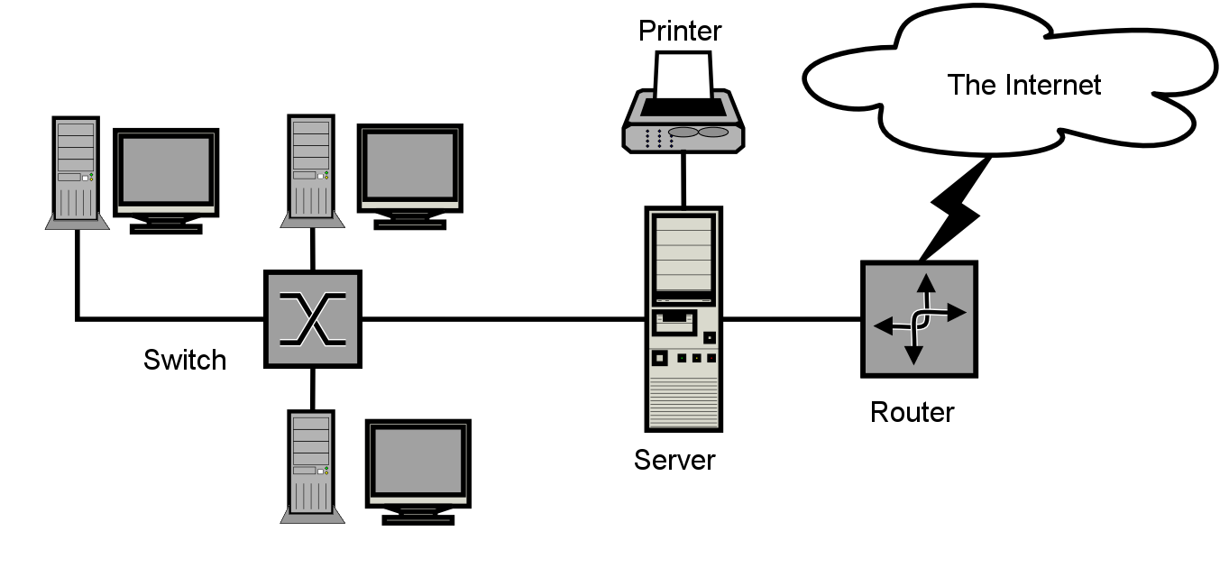
Recent Security Incident
Last quarter our networking systems were attacked with a Denial-of-Service (DoS) attack. More specifically a Distributed DoS attack due to running Windows XP, 7, 8, and 10
The hacker gained access using an open USB port at one of our retail stores. The attack overwhelmed the network servers with useless traffic, rendering our services unavailable to legitimate customers
While no physical damage occurred, we lost sales do to our software not being able to service customer requests
(Wikimedia Commons, 2017)
(Wikimedia Foundation, 2017)

Slide 16
How the hackers were successful
The attacker used an open USB drive to deliver the DDoS payload. Simply inserting the drive activated Plug-n-Play, running the software upon insertion
The software turned the PoS software into a botnet zombie compromising multiple terminals and overwhelming our SQL servers
Windows XP is known for such vulnerabilities due to ended development of security issues in 2014
(Wikimedia Commons, 2017)
(Wikimedia Foundation, 2017)

Slide 17
Recommendations for future attacks
The most expensive option is replacing our operating systems with more secure software. That would cost tens of thousands of dollars. Another option is to physically disable the USB drives on retail terminals. For example, putting cement in the port to disable access. IBM did this in 2018 (Lewis, 2018).
We have ten stores and the process would take about two minutes per terminal. A simple chore that would eliminate future attacks of this specific type of DDoS.
It is difficult to determine how much money was lost during the attack from our retail stores however this vulnerability is open to different more costly attacks.
(Wikimedia Commons, 2017)
(Wikimedia Foundation, 2017)

Slide 18
A more secure future
The cost to prevent future DDoS attacks of this same type, is minimal but as the Network Engineer, I encourage Disony Entertainment to move the retail software and communications to a cloud service provider.
Separating the retail services with the corporate services will add an additional level of security. While also providing much needed new software for the retail stores. Windows XP is full of risks and unpatched vulnerabilities.
According to Microsoft and the level needed for our services, thats 20 virtual CPUs, our cost is $2.48 an hour (Microsoft, 2024).
(Wikimedia Commons, 2017)

Slide 19
INTRODUCE THE EXPERT
As a web manager, my role involves overseeing and maintaining our company's website to ensure its functionality, performance, and user experience. My responsibilities include:
Day-to-day maintenance: Regularly checking and updating the website to ensure it is functioning properly and remains up-to-date.
Content management: Creating and updating website content to keep it accurate, engaging, and aligned with the company's objectives.
Website performance: Monitoring the website's speed, responsiveness, and user experience, and addressing any issues that may impact performance.
Hosting and server management: Ensuring the website is properly hosted and the server is secure and reliable.
Website upgrades: Implementing new features, improving functionality, and staying abreast of the latest web technologies.
Testing and quality assurance: Conducting regular testing to ensure the website functions correctly across different platforms and resolving any bugs or errors.
SEO and analytics: Optimizing the website for search engines, analyzing website analytics, and making data-driven decisions to enhance performance.
Security and data protection: Implementing security measures to safeguard the website from cyber threats and ensuring user data is protected.
In addition to these responsibilities, I also oversee processes such as content creation and management, website design and development, e-commerce functionality, social media integration, and online marketing campaigns. This role is crucial in maintaining the company's online presence and ensuring a seamless user experience for visitors to the website.
Web Manager
(Wikimedia Commons, 2017)

Slide 20
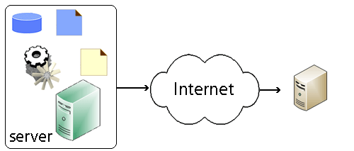
Recent Security Incident
In October 2023, 23andMe suffered from an attack from hackers
More than 7 million user accounts were connected to compromised accounts
No monetary loss has been revealed as it is still ongoing
Hackers gained access to customers accounts by using a process called credential stuffing.
This attack shows the importance of changing username and passwords for all websites you access.
(Wikimedia Commons, 2017)
(Krauss, 2010)

Slide 21
Tools a hacker would use to gain access - Software
Brute forcing: Hackers can use software tools that automate the process of trying different combinations of usernames and passwords until they find the correct credentials to gain access.
SQL injection: This technique involves exploiting vulnerabilities in a web application's database query system to gain unauthorized access to the database.
Packet sniffing: Hackers can use packet sniffing tools to intercept and analyze network traffic, allowing them to capture sensitive information such as login credentials.
Exploiting software vulnerabilities: Hackers can take advantage of known vulnerabilities in software applications to gain unauthorized access. They may use tools that automate the process of identifying and exploiting these vulnerabilities.
Stolen backup tapes: In some cases, hackers may gain access to a company's backup tapes, which contain copies of the web and database assets. They can use software tools to extract and access the data stored on these tapes.
(Wikimedia Commons, 2017)
(Krauss, 2010)

Slide 22
Tools a hacker would use to gain access - Hardware
Network scanning tools: Hackers can use hardware tools such as network scanners to identify open ports and services on our company's network. This information can help them find potential entry points for unauthorized access.
Hardware keyloggers: These devices can be physically installed on a computer to capture keystrokes, allowing hackers to obtain login credentials and other sensitive information.
(Wikimedia Commons, 2017)
(Krauss, 2010)

Slide 23
Recommendations for system upgrades
Web Manager.
Redevelop the website to PHP version 8.2 from the current 4.0
Redevelop the database to the current MySql version
Transfer all data storage offsite to AWS
Implement Asymmetric encryption within the database to keep data secure.
restructure mobile applications to be supported by new backend.
(Wikimedia Commons, 2017)
(Krauss, 2010)

Slide 24
System upgrades cost
Web Manager.
PHP version upgrade - $10,000
MySql version upgrade - $1,000
Transfer all data storage offsite to AWS - $4024.32 per month
Asymmetric encryption - $12.00 per 10,000 requests
Mobile application restructure - $5,000
Total yearly cost - $64,411.32
(Wikimedia Commons, 2017)
(Krauss, 2010)

Slide 25
SUMMARY
DISONY is a company that sells variety of entertainment products. They have more than 19K customers and have made more about 8 million revenue from sales made through online, Amazon and their 10 stores located In United States.
The company uses Windows 2000 and their website was written in 2003, most of their certificates are over 10 years old.
They have had several security breaches recently
Outdated Point of sale (POS) was one of the vulnerability and they installed malware transaction process. This caused them in significant financial losses and legal penalties.
Denial of Service (DOS) attack, which overwhelmed the network services with useless traffic. the hacker used open USB to upload DDoS payload. This caused the company to not make any sales activities.
Comprised user information was also another attack, which caused them more than 7 million user account to be compromised. This was caused by Hackers gained access to customers accounts by using a process called credential stuffing.
Tool used by the hacker are, SQL injection, Buffer Overflow and outdated certificates.
Some way to prevent this kind of attacks: make sure the website doesn't accept special characters. have length requirement for user input and always have your certificates upto date.

Slide 26
REFERENCES
23andMe. (2023, October 7). Addressing Data Security Concerns. 23andMe Blog. https://blog.23andme.com/articles/addressing-data-security-concerns?utm_medium=search_brand&utm_source=google&gad_source=1&gclid=CjwKCAiAlJKuBhAdEiwAnZb7lR5MRapS8c4DSLQRcKZ8v2Bk9SZ5Vjo_4A7G2HTbNuIf_1MM5gCzDBoCzB4QAvD_BwE&gclsrc=aw.ds
AWS. (2019). AWS Pricing Calculator. Calculator.aws. https://calculator.aws/#/
Colin (2013). Backlit Keyboard [Image]. Wikimedia Commons. https://commons.wikimedia.org/wiki/File:Backlit_keyboard.jpg
Editor, C. C. (n.d.). attack - Glossary | CSRC. Csrc.nist.gov. Retrieved February 11, 2024, from https://csrc.nist.gov/glossary/term/attack#:~:text=Definitions%3A
Euatham, K. (n.d.). Loyalty Card [Icon]. Noun Project Inc. https://thenounproject.com/term/loyalty-card/2162012/

Slide 27
REFERENCES
Lewis, N. (2018 October 19). Removable Storage Devices: Why are Companies Banning Them? Tech Target. https://www.techtarget.com/searchsecurity/answer/Removable-storage-devices-Why-are-companies-banning-them Microsoft. (2024). Cloud Services Pricing. https://azure.microsoft.com/en-us/pricing/details/cloud-services/
NCSC. (2015, October 14). Understanding Vulnerabilities. Www.ncsc.gov.uk. https://www.ncsc.gov.uk/information/understanding-vulnerabilities
Sample-Network-Diagram [Image]. (2006). Wikimedia Foundation. https://en.wikipedia.org/wiki/File:Sample-network-diagram.png User Avatar Person Info Information [Image]. (2017). Wikimedia Commons. https://commons.wikimedia.org/wiki/File:User_Avatar_Person_Info_Information-512.png
Wikipedia Contributors. (2019, October 21). Threat (computer). Wikipedia; Wikimedia Foundation. https://en.wikipedia.org/wiki/Threat_(computer)

